Slide 1
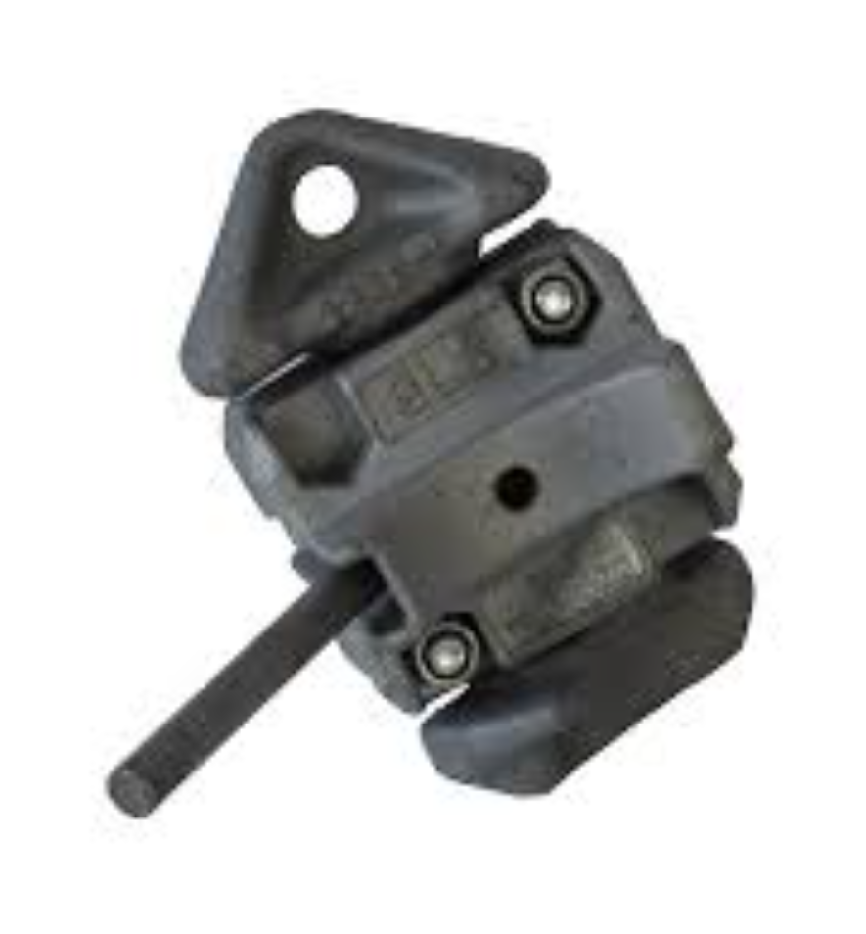

Auto Lock
for Cargo Containers
Quick, Strong, and Effective
By: Cyborg Robotics
Notes:
Aryan speaks:

Slide 2
What is the problem we decided to solve?
Cargo loss is a major problem at sea. Hundreds of thousands of dollars are wasted as huge cargo containers fall from the ship. Locks constantly get splashed with sea spray causing them to be brittle and break. Most locks nowadays are manual which takes a lot of time to lock. We think that automating the system would help ships sail faster and more efficiently.
Notes:
Ashvik speaks:

Slide 3
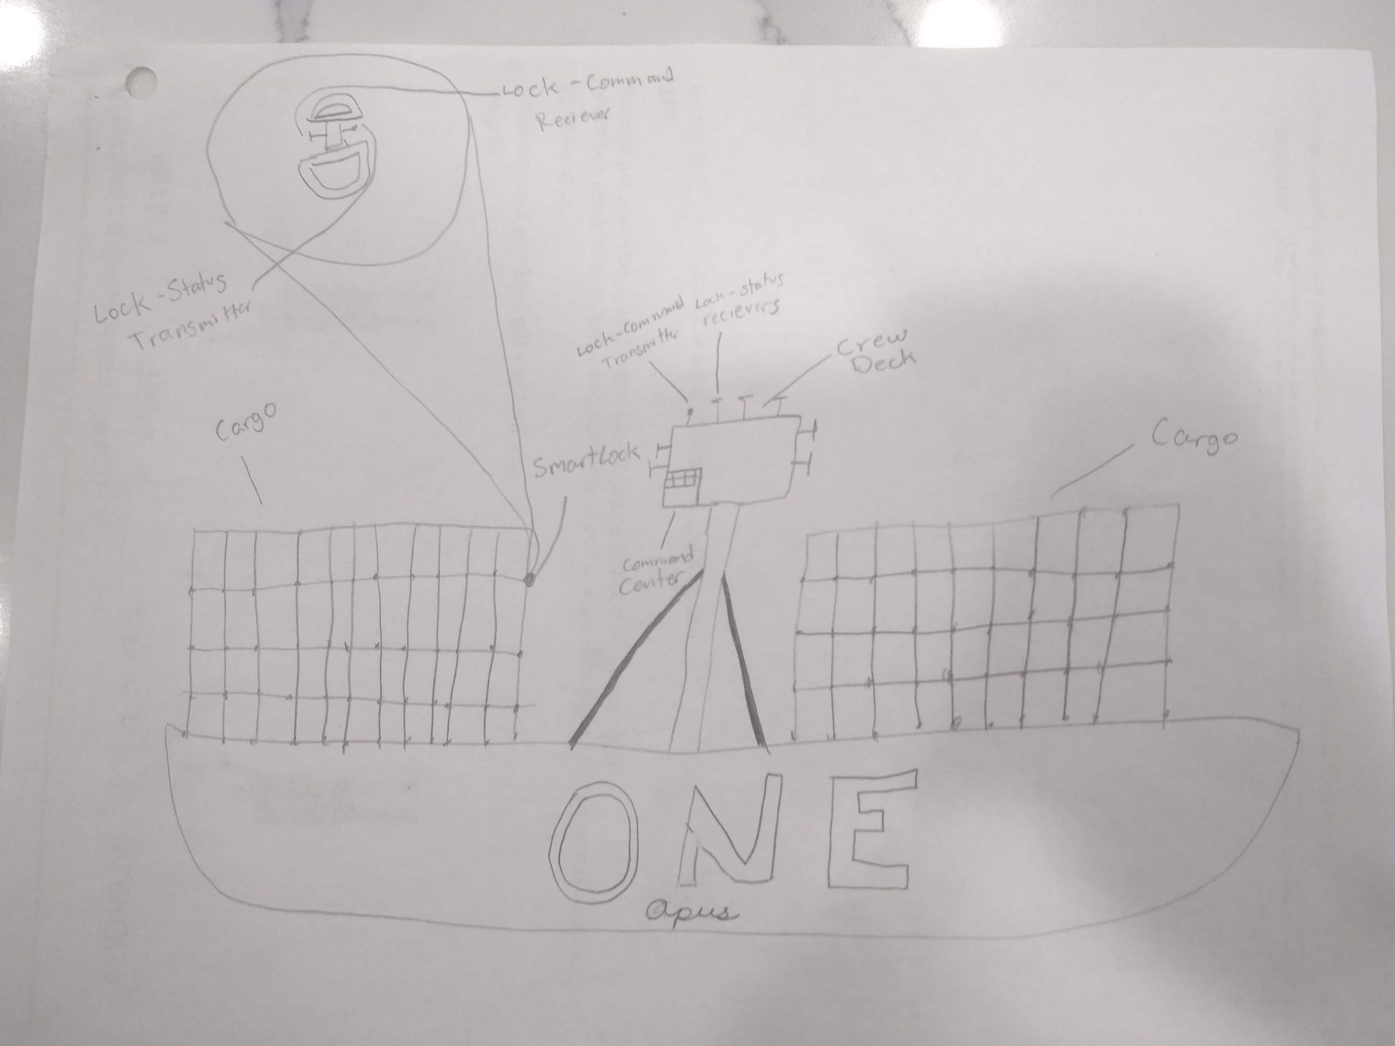
Solution
Our solution is an automated lock which is strong enough to . The carbon steel iron nickel alloy galvanized with zinc is impact resistant and waterproof. The alloy all together costs around $1.02 per lb.
Notes:
Aryan speaks:
We chose to galvanize with zinc, because it makes the metal more waterproof and protects it from corroding quickly. We also decided to add silicon on the motor/gearbox, to further increase it’s time of non-corrosion.

Slide 4
How we made our solution better
We split into groups because we want to include all ideas.
Ideas we came up with included catching fallen cargo with a tugboat or getting higher or lower quality with higher or lower pay.
We decided to add a validation check to make sure all the locks were secure.
We also thought voting would make it fair
We decided to make the lock waterproof, using silicon, because all the technology would short-circuit if water were to come in contact with them.
Notes:
Arjun speaks:

Slide 5
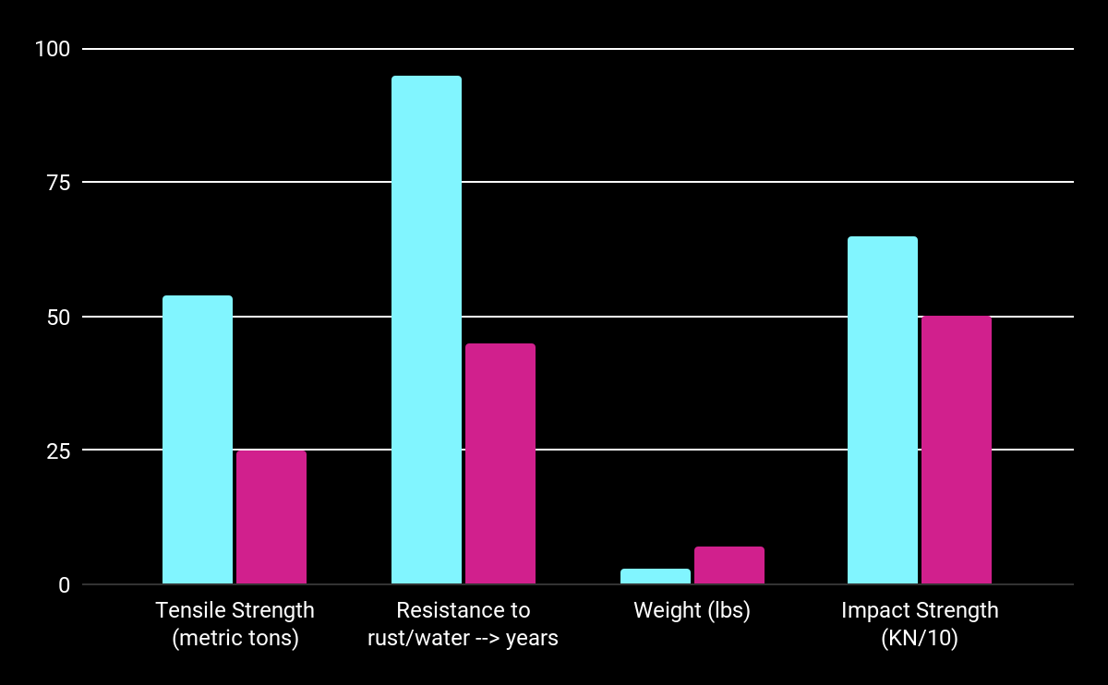
Market
Our Lock
Average Twist Lock
Notes:
Time-1 minute for market slides
Aryan and Sid speak on this slide
Our Lock Twist Lock
Tensile Strength (metric tons) 54 25
Resistance to rust/water → years 95 45
Weight (lbs) 3 7
Impact Strength (KN/10) 65 50

Slide 6
SWOT ANALYSIS
STRENGTHS
WEAKNESSES
OPPORTUNITY
THREATS
Durable, water-proof, cost-efficient and eco-friendly.
Every 20 years we need to fix the layer of silicon coating.
We are the only people in the market so we can take another step in automation.
Other companies can copy our materials and add more circuitry meaning business could go down.
Notes:
Strengths - Aryan
This product would sell for shipping companies like the vessel line ONE
Pretty cheap per ship averaging at around $10,000 per ship compared to $5,000,000 worth of lost products
Weakness - Arjun
Opportunity - Sid
Threats - Abhi

Slide 7
Impact
Cargo loss will decrease dramatically
Shipping will become more reliable
Our Remodeled Lock provides most of the many benefits without costing a lot
The overseas shipping industry would soar in price
Customer satisfaction/company reputation would increase because of less cargo falling overboard
Notes:
Impact - Marco
How to Read the Slides:
Do it calmly
Don’t speak too quickly
Add detail
Don’t flub your words
Be relaxed

Slide 8
Summary
The Auto Lock addresses the problem that twist locks on cargo ships aren’t strong enough to hold cargo containers on rolling seas. Around 1400 cargo containers are lost at sea every year, and we are looking to solve this. We think the Auto Lock is a great solution because:
It’s cost-efficient—the galvanized carbon steel costs $1.02 per pound. Since we are using 5 kg per lock, the metal of each lock would cost about $11.34.
The Auto Lock is durable as the zinc coating defects salt and the silicon is waterproof, preventing rust and letting it work efficiently.
The metal is quite strong, being able to withstand about 121,000 psi of force. This means the lock will stand, even through the harsh sea.
The solution of our Auto Lock will be able to save many, many containers, which decreases the shipping product losses and boosts the industry and the economy.
Notes:
Summary-Ridhiman

Slide 9
Notable Resources
Transmitters and Receivers Link
Alloy Additions to the Kettle and Their Purposes
Strength of High carbon steel
Galvanized Steel: Types, Uses, Benefits
How Container Shipping Works — World Shipping Council
Container Losses In The Rolling Seas
MetalMiner Prices: Carbon Steel Prices
What Are the Top 10 Strongest Metals on Earth?
About Twistlocks
Psi to tonnes conversion table (inches)
Notes:
Abhi

Slide 10
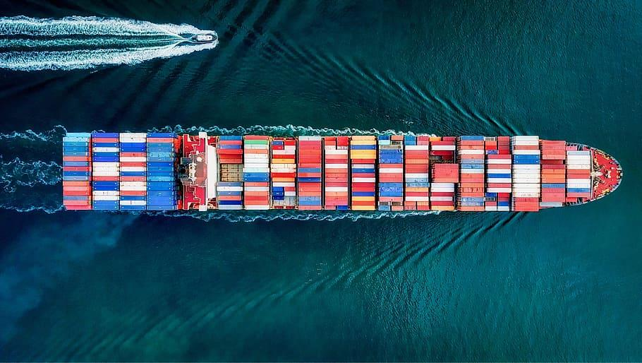
Thank You For Listening!

Slide 11


Slide 12

Made By: Cyborg Robotics

